Slide 1
Haor Flood Management and Livelihood Improvement Project (BWDB Part) Recent Progress Report
Presented By
A.K.M Shamsul Alam,
Project Director

Slide 2
Contents of The Presentation
Flood Situation in the project area(Damage)
Revised design/Design of the pilot embankment construction and plan for implementation of pilot construction.
Activity plan for civil works next two dry seasons
Status of Agriculture component and plan for next FY
Discussion on civil works monitoring format

Slide 3
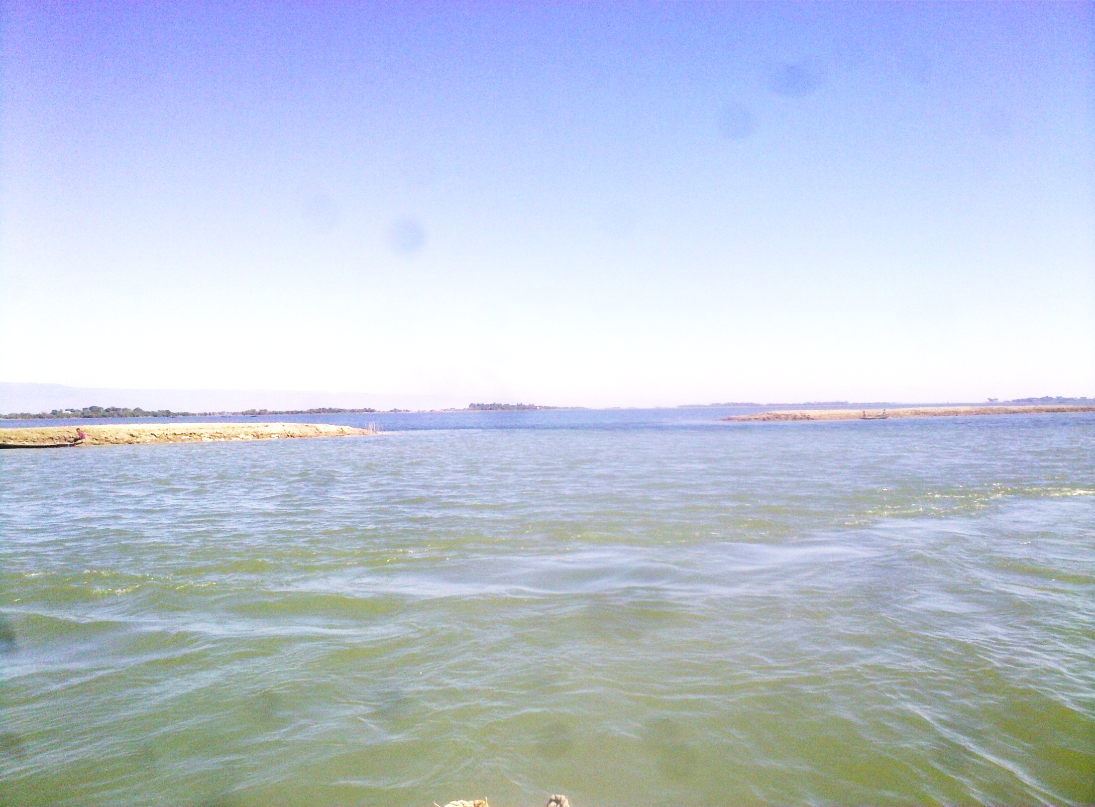
Haor area during pre monsoon

Slide 4
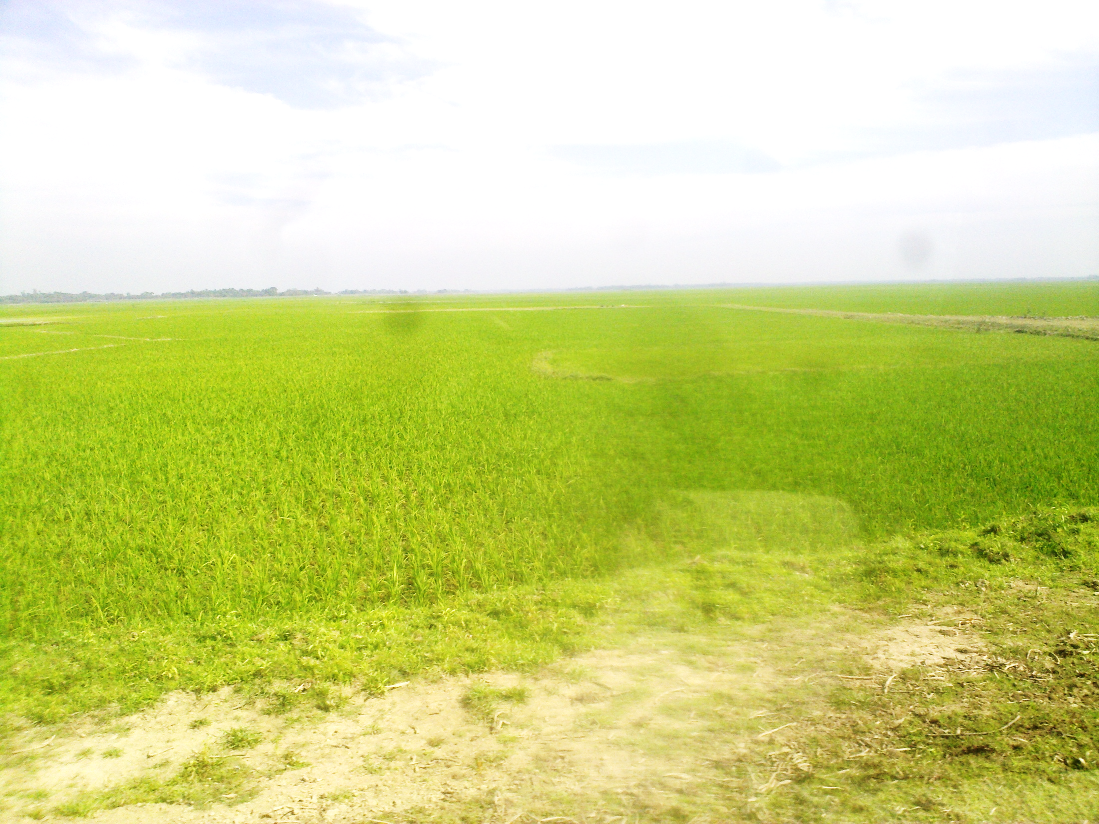
Boro rice field during dry season in haor area

Slide 5
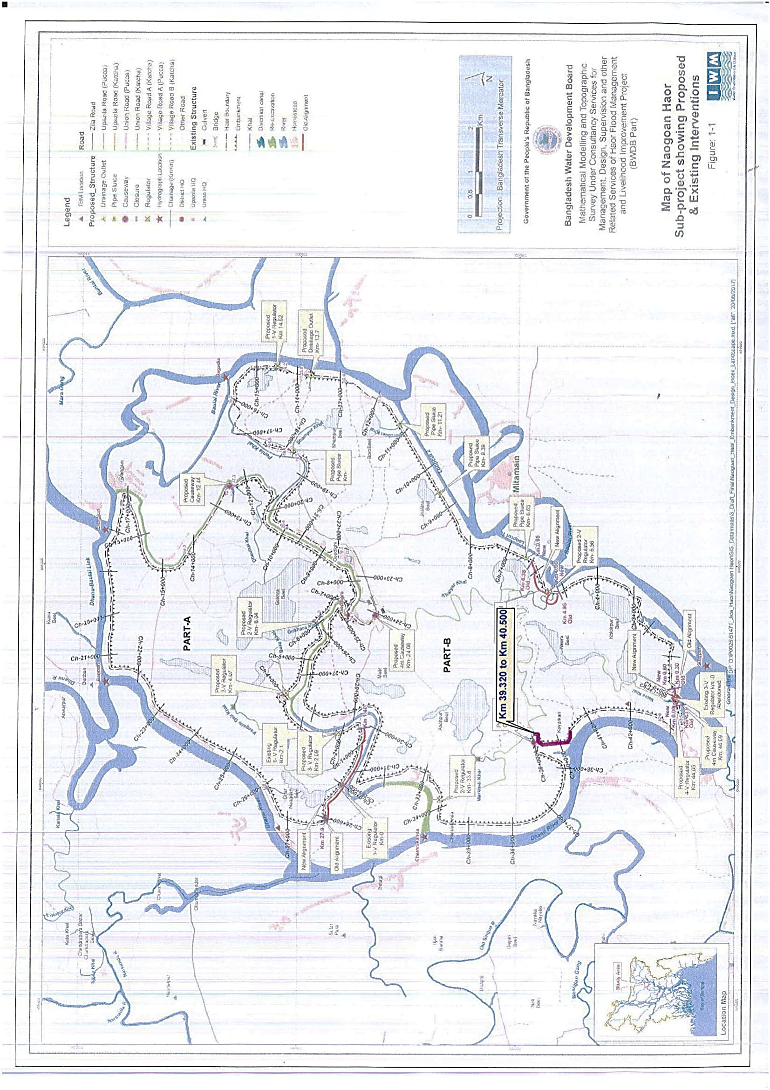

Slide 6
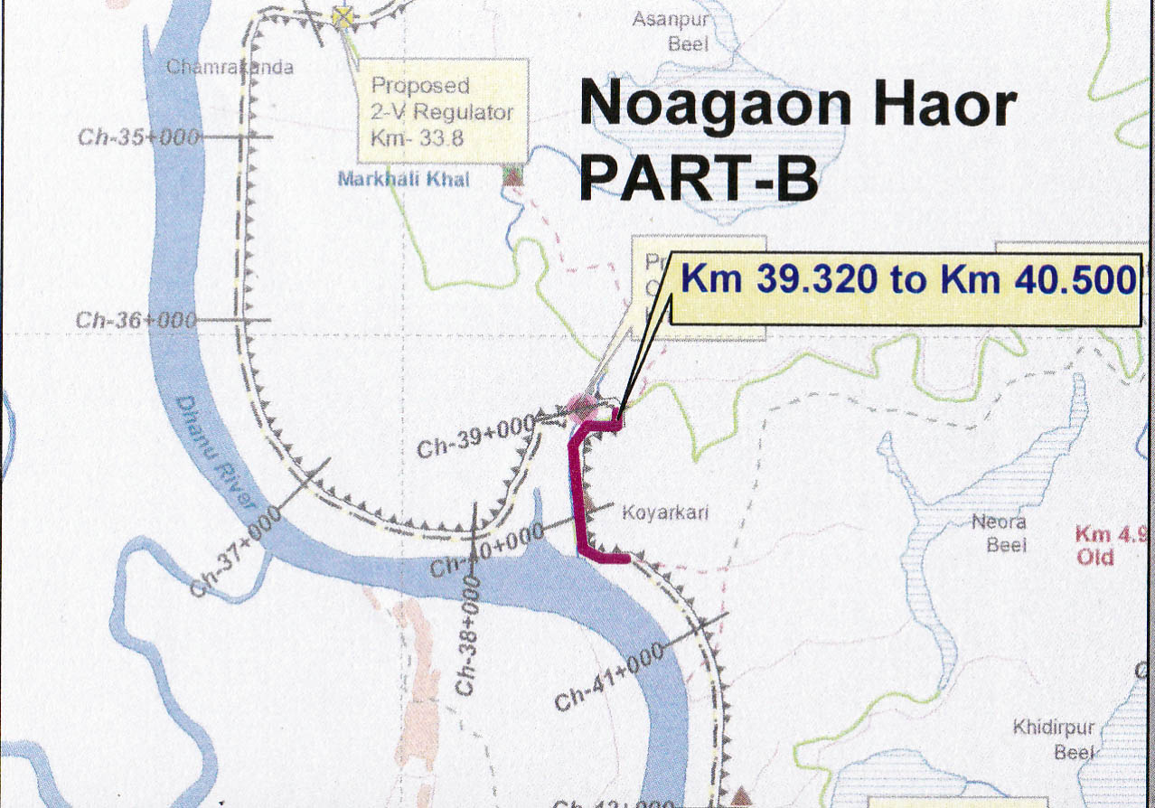
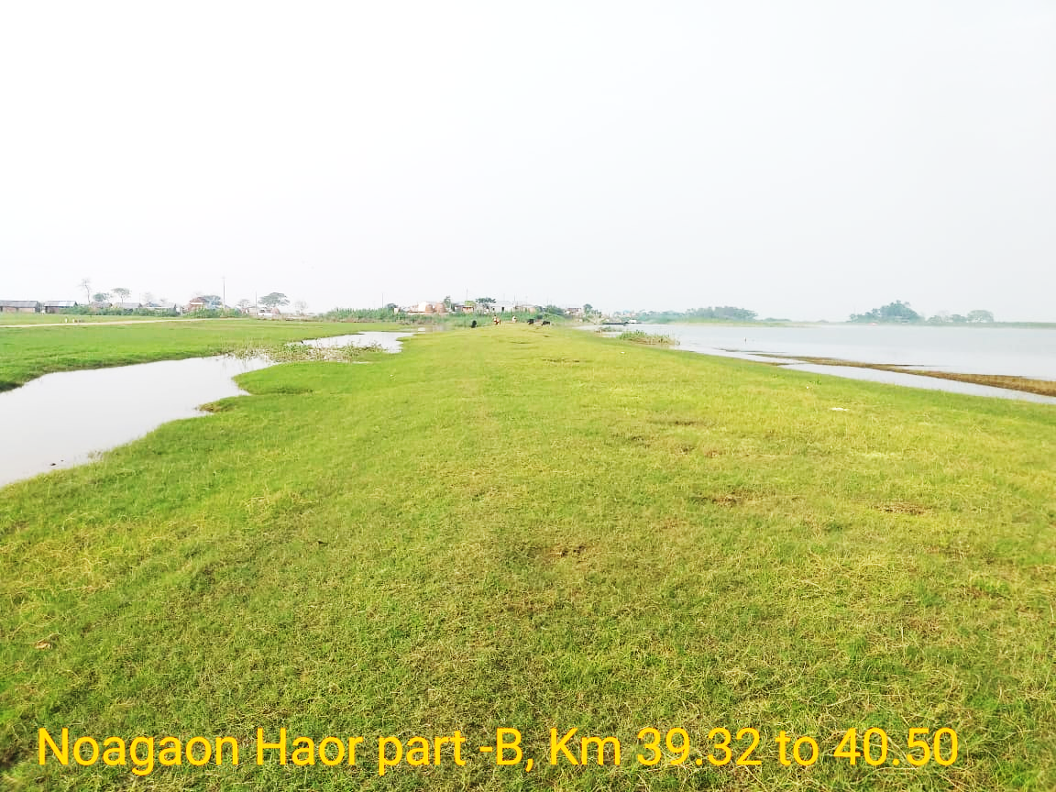
3.2 Findings (Noagaon Haor Part-B 39.32 to 40.50)
05-11-2020
Dec 11, 2019
March 9, 2020

Slide 8
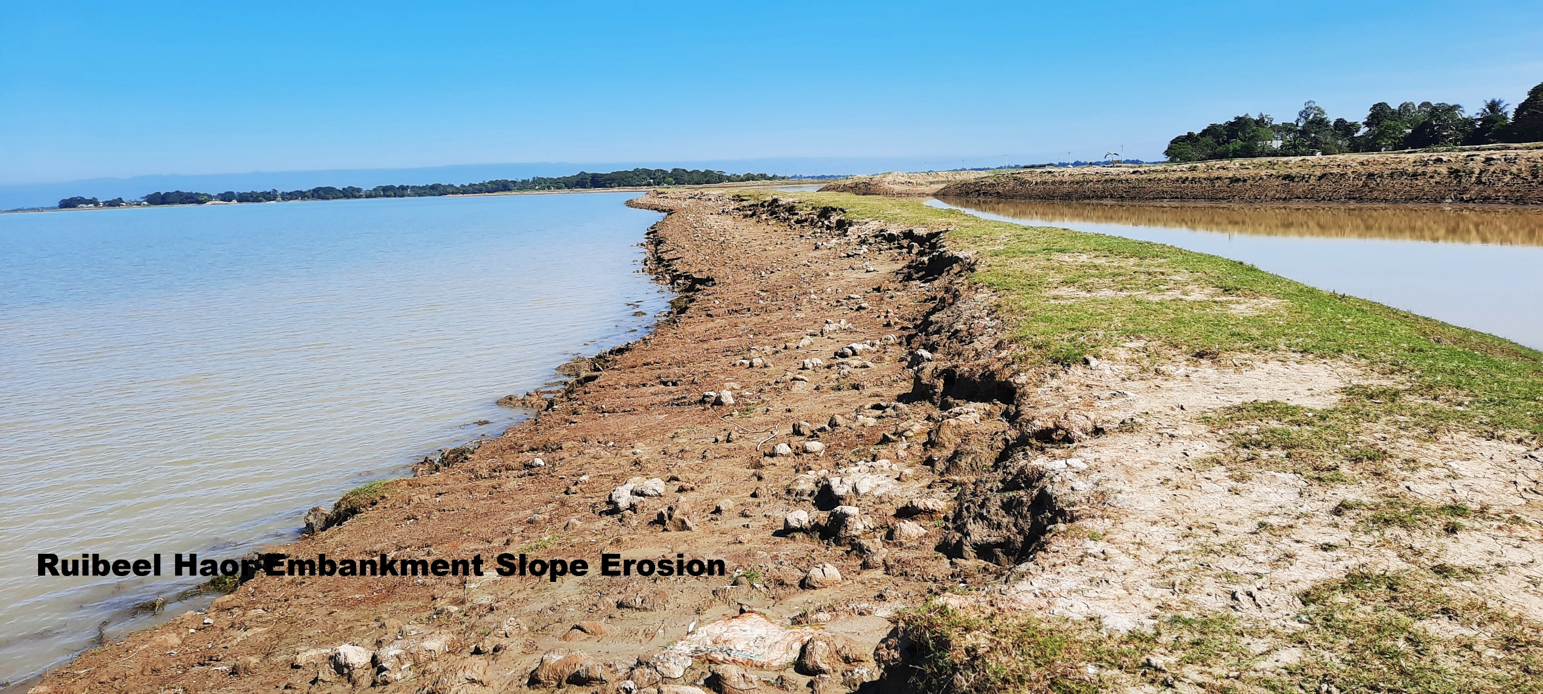
3.2 Findings (Dharmapash Rui Beel at3.500 km 29-10-2020)
Ch. at 35.500 km
Photos taken on 30-10-2020

Slide 9
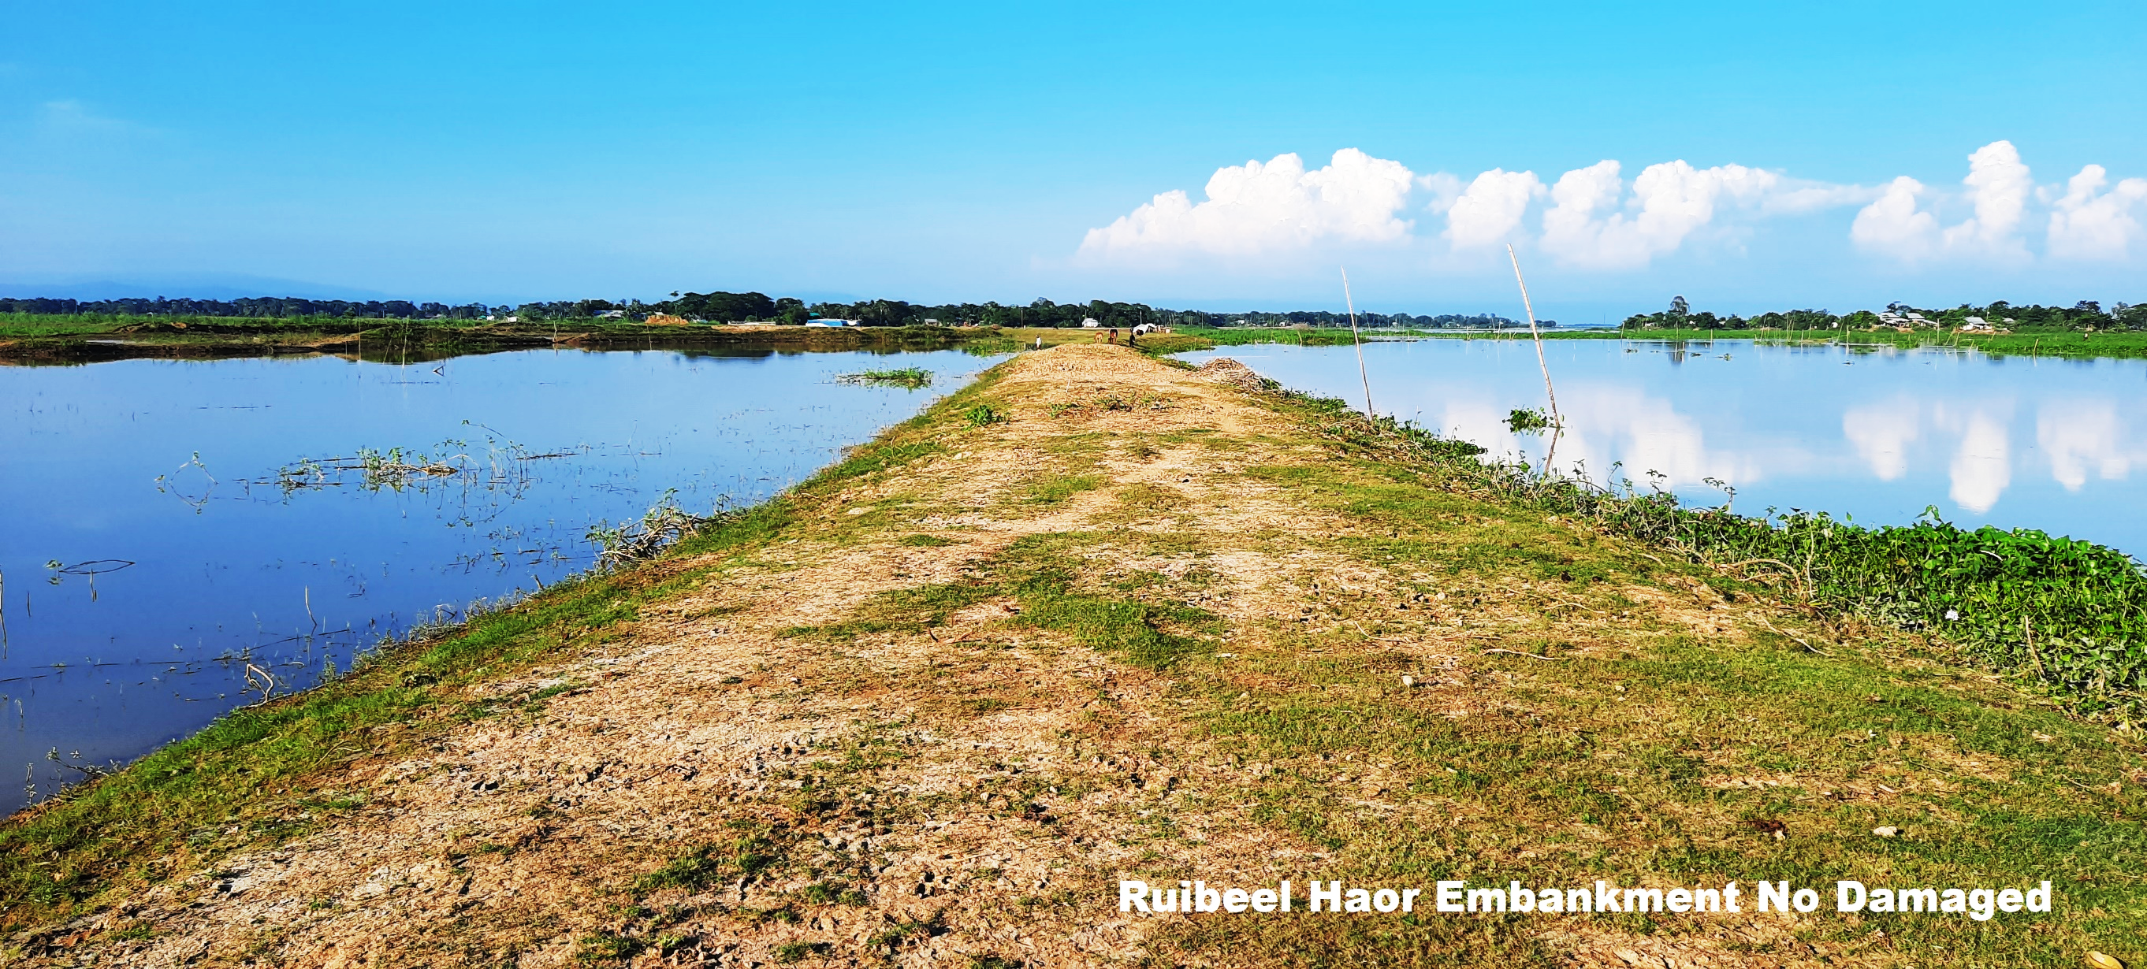
Ch. at 02.100 km
Photos taken on 29-10-2020

Slide 10
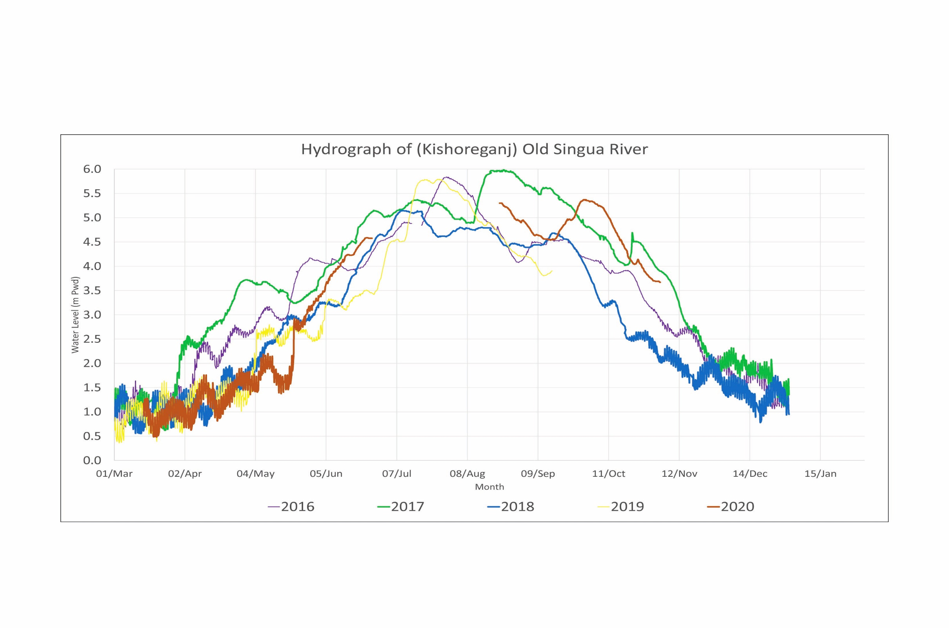

Slide 11
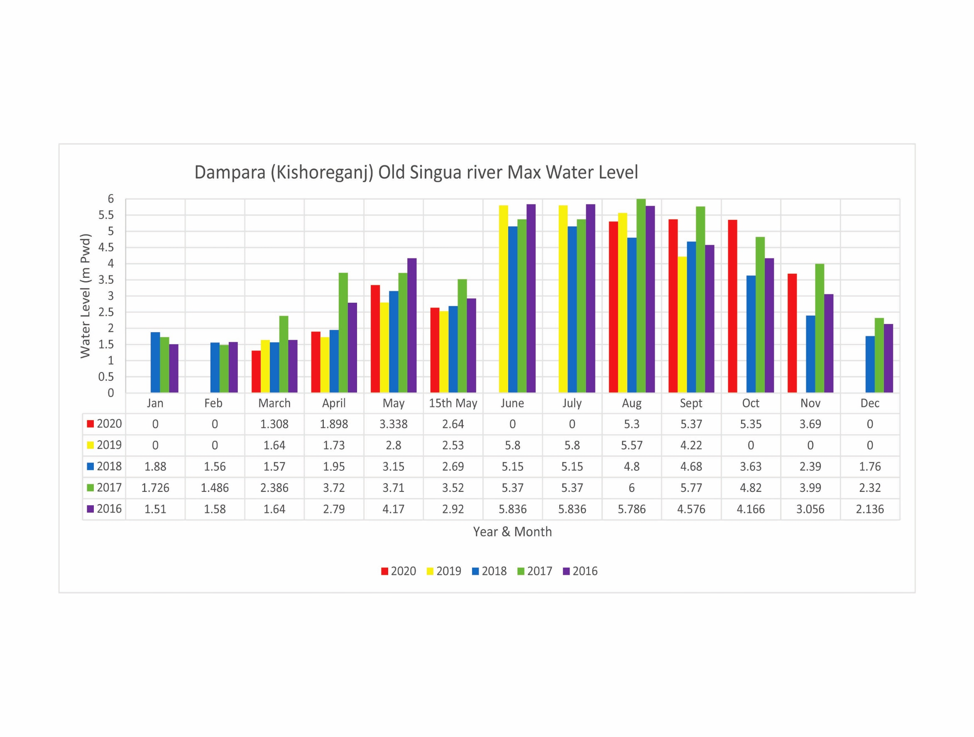
Avg. Crest level of S/E 4.50 m-PWD
Max WL at 15th May 3.52 m-PWD
Average GL 2.10 m-PWD

Slide 14
Avg. Crest level of S/E 6.57 m-PWD
Max WL at 15th May 5.00 m-PWD
Average GL 4.50 m-PWD

Slide 16
2. Revised design/Design of the pilot embankment construction and plan for implementation of pilot construction.
2.1 Type A Protection Work
2.2 Type B5 Protection Work
2.3 Flood Fuse

Slide 17
Total estimated cost for 7 (Seven) nos. Packages for Protection of Damaged Portion of Embankment:
Sl. No. | Name of Haor | Type- A | Type- B | Type- D | Fuse Type (Length in km.) | Total length (km) | Total estimated cost (in Million BDT) | Date of Tender Floated | Date of Tender Receive | Remarks
 |  | (Length in km.) | (Length in km.) | (Length in km.)
1 | 2 | 3 | 4 | 5 | 6 | 7 | 8 | 9 | 10 | 11
1 | Naogaon Haor Part–A Kishoregonj, BWDB/Kish/HFMLIP/ PW-30). | 1.681 | 0.700 | 0 | 0 | 2.381 | 146.983 | 11/8/2020 | 12/7/2020
2 | Naogaon Haor Part–A Kishoregonj, BWDB/Kish/HFMLIP/ PW-31) | 0.990 | 1.640 | 0 | 0.030 | 2.660 | 120.028 | 11/8/2020 | 12/7/2020
3 | Naogaon Haor Part–B Kishoregonj (BWDB/Kish/HFMLIP/ PW-32) | 1.082 | 1.542 | 0 | 0.030 | 2.654 | 156.373 | 11/8/2020 | 12/7/2020
4 | Kishoregonj Naogaon Haor Part–B, Kishoregonj (BWDB/Kish/HFMLIP/PW-33) | 1.090 | 0 | 1.155 | 0.000 | 2.245 | 146.843 | 11/8/2020 | 12/7/2020
5 | Dakshiner Haor/ Noagaon Haor (BWDB/Kish/HFMLIP/PW-34). | 1.094 | 1.097 | 0 | 0.045 | 2.236 | 147.702 | 11/8/2020 | 12/7/2020
6 | Dakshiner Haor/Noapara Haor/ Nunnir Haor (BWDB/Kish/HFMLIP/PW-35) | 0.620 | 4.425 | 0 | 0 | 5.045 | 91.462 | 11/8/2020 | 12/7/2020
7 | Dharmapasha Rui beel Project. Sunamgonj (BWDB/Sunam/HFMLIP/PW-07) | 0.341 | 3.039 | 0 | 0.060 | 3.440 | 127.007 | 10/21/2020 | 11/23/2020
 | Total | 6.898 | 12.443 | 1.155 | 0.165 | 20.661 | 936.398

Slide 18
Protection Type (Type A)

Slide 19
Protection Type (Type B5)

Slide 20
Flood Fuse

Slide 21
Flood Fuse

Slide 22
Flood Fuse

Slide 23
1. Activity Plan for civil works next two dry season
1.1 Physical Achievement up to October 2020
1.2 Current Activities of Component 3-1
1.3 Current Concerns

Slide 24
1.1 Physical Achievement up to 30thOctober, 2020
Sl No. | Item of Physical Work as per 1st RDPP |  |  |  |  | Progress up to 30th October, 2020 | Progress (%)
 | Name | Quantity | No of Package | Cost in Crore Taka | On going Packages
1 | 2 | 3 | 5 | 4 | 6 | 7 | 8
New Haor: (14 Nos.) |  |  | 52 Nos |  | Kishoregonj 27 Nos. Habigonj 6 Nos. Netrokona 8 Nos. Sunamgonj 6 Nos. Total 47 Nos. Contract Price of 47 Nos. Packages = 472.37 Crore
1 | Construction of Submersible Embankment | 263.24 km |  | 119.53 |  | 156 km (Full) +54 km (Part)= 210 km | 72.57%
2 | Re-excavation of Khal/River | 318.20 km |  | 97.29 |  | 187 km (Full) +73.00 km (Part) = 260 km | 72.53%
3 | Construction of Regulator/ Causeway/Drainage Box Outlet | 137nos (57+35+1+44) |  | 203.11 |  | 50 nos. (Full) +30 nos. (Part) = 80 Nos. | 49.64%
4 | Construction of Irrigation Inlet | 131 nos. |  | 12.61 |  | 43 nos. (Full) +17 Nos. (Part) = 60 Nos. | 40.61%
5 | Rehabilitation of Regulator | 8 nos. |  | 1.66 |  | 1 No (Full) = 1 No. | 12.50%
Rehabilitation Haor: (15 Nos.)
1 | Construction of Submersible Embankment | 87.03 km |  | 17.85 |  | 51 km (Full) +4 Km (Part) = 55 km. | 61.36%
2 | Construction of Full Embankment | 84.31 km |  | 25.50 |  | 53 km (Full) +12 km (Part) = 65 km | 71.40 %
3 | Re-excavation of Khal/River | 143.00 km |  | 25.15 |  | 65 km (Full) +15.00 km (Part)= 80 km | 51.75%
4 | Re-installation/Construction of regulator/ Causeway | 7 nos. |  | 15.15 |  | 1 No. (Full) = 1 No. | 14.29%
5 | Replacement of Gate | 104 nos. |  | 3.63 |  | 43 nos. (Full) = 43 Nos. | 41.35%
6 | Construction of WMG Office | 60 Nos. |  | 13.80 |  | 4 nos. (Full) +4 Nos. (Part) = 8 Nos. | 10.67%
 | Total |  | 52 Nos. | 535.27
Physical Progress = 63 %

Slide 25
Financial Status of JICA Money
SL | Description | Amount
1. | Total Fund for Livelihood & Physical work | = 515.44 Crore
2. | Total expenditure up to Sept. 2020 | = 294.18 Crore
 | Remaining Fund | = 221.26 Crore
Fund requirement
1. | October to December, 2020 | = 4.20 Crore
2. | January to March, 2021 | = 41.70 Crore
3. | April to June, 2021 | = 85.00 Crore
 | Total | = 130.90 Crore
Fund requirement
 | July, 2021 to June, 2022 | = 90.30 Crore

Slide 26
Sl. No. | Tender Status as per 2nd RDPP | Remarks
1 | 55 Nos of Packages As Per 2nd RDPP 47 Packages already Tender and work is on going.8 Nos Packages is Completed Upto October,2020.
2 | Remaining 9 Packages are to be tendered the F/Y (2020-21) ,already for 8 nos package tender is floated. 1 no Package for Gate Replacement at Satdona & Chahal Beel Sub-Project in Brahmanbaria District.
Financial Year | Tender Invitation (No) | Package Completion (No)
2016-17 | 9 | 3
2017-18 | 19 | 4
2018-19 | 15 | 1
2019-20 | 4
2020-21 | 8
Total | 55 | 8

Slide 27
Cumulative Progress of Project (upto 30-09-2020) : Financial = 59381.08 Lakh (61.09%)
Project Progress = 73%
Reasons for difference of progress (Financial & Physical).
RDPP Item & Task with cost | Expenditure incurred (%) | Physical (%)
Consultancy: Total amount : Tk. 7901.40 Planning Review Sub Soil Investigation Design Estimate Monitoring & Supervision RAP Implementation Environmental Study | 5618.01 (71.10%) | 80%
Physical Work : Total amount : Tk. 53727.00 Detailed Estimate Tender Float Notification of Award (NOA) Work Order (W/O) Mobilization Work done | 30875.04 (57.47%) | 68%
RDPP Item & Task with cost | Expenditure incurred (%) | Physical (%)
Land Acquisition 240 ha Tk. 24000.00 (Lakh) | 15323.60 (63.85%) | 65%
Tax and VAT : Total amount : Tk. 2596.27 | 1809.73 (69.70%) | 69%
Procurement of Goods & Vehicles : Total amount : Tk. 1066.22 | 856.62 (80.34%) | 80%
Office Administration: Total amount : Tk. 3660.54 Salary of Out Sourcing staff Office Rent Gas & Petrol Repair Maintenance Others | 2228.44 (60.88%) | 60%
Total : Tk. 97204.86 | 59381.08 (61.09%) | 73%
Contingency : Total amount : Tk. 660.14 | 0 | 0
Grand Total amount : Tk. 97865.00 | - | -
Livelihood Improvement by Agriculture Promotion: Total amount : Tk. 4253.43 Local Training APSS SIGS | 2669.63 (62.76%) | 69%

Slide 30
Financial Expenditure (In Million BDT)
Sl no | Financial Year | Physical Progress | GOB | Project Aid (PA) |  |  |  | Total | Cumulative expenditure (in Million BDT)
 |  |  |  | RPA |  | Total RPA | DPA For Consultant
 |  |  |  | Civil Works | Livelihood
1 | 2 | 3 | 4 | 5 | 6 | 7 | 8 | 4+5+6+7
1 | 2014-15 | 1.5% | 60.662 | 0.0000 | 0.00 | 0.00 | 84.96 | 145.6 | 145.6
2 | 2015-16 | 4.0% | 82.428 | 0.0000 | 0.92 | 0.92 | 184.94 | 268.3 | 413.9
3 | 2016-17 | 10.5% | 555.849 | 91.2730 | 34.91 | 126.18 | 109.32 | 791.3 | 1205.3
4 | 2017-18 | 19.0% | 782.197 | 656.3710 | 78.98 | 735.35 | 68.93 | 1586.5 | 2791.7
5 | 2018-19 | 17.0% | 631.334 | 970.3530 | 93.99 | 1064.35 | 68.64 | 1764.3 | 4556.1
6 | 2019-20 | 15.0% | 312.082 | 975.1960 | 39.82 | 1015.01 | 45.00 | 1372.1 | 5928.2
7 | 2020-21 (30thSept-20) | 1.0% | 9.948 | 0.0000 | 0.00 | 0.00 | 0.00 | 9.948 | 5938.1
Total |  | 68.0% | 2434.5 | 2693.2 | 248.6 | 2941.8 | 561.8 | 5938.1

Slide 31
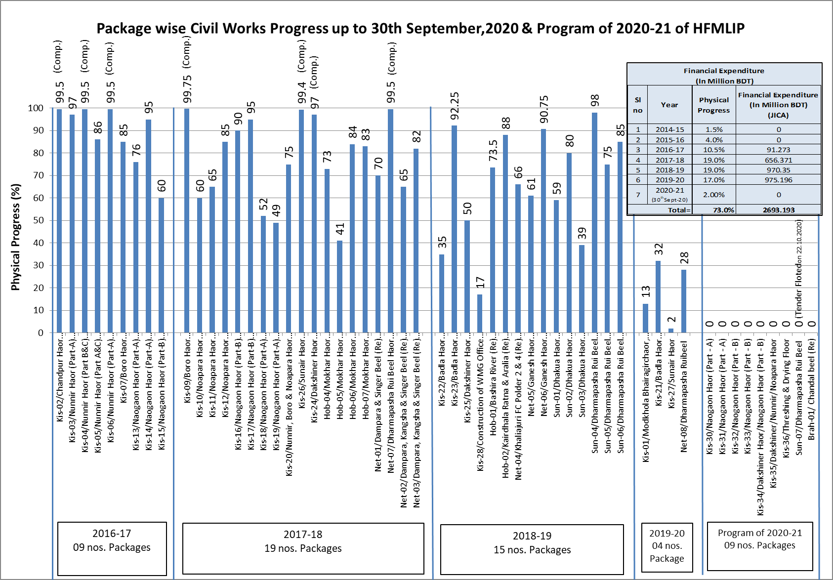

Slide 32
1.2 Current Status of Component 3-1
 | Scope | Major Activities | Target in DPP (2nd rev) | Achievement up to June-2020
A | WMO | - Committee Formation | 373 | 319
B | Local Training | - BWDB officials, Field staff, WMG members. | 13,740 WMG Members | 9,400 WMG Member
C | Agriculture Promotion Support Sub-Project (APSS) | - Farmer Training Program, - Demonstrations of crops, rice. - Farmer School Establishment | 72,447 Members | 43,542 Members
D | Small Scale Income Generation Sub-Project (SIGS) | - Homestead Vegetable - Cultivation and Support Service, etc | 28,667 Members | 19,653 Members
Total |  |  | 1,14,854 Members | 72,595 Members

Slide 33
4. Status of agriculture component and plan for next FY
BDT in Lakh

Slide 36
Allocation & Achievement Shown in Graphs
Upto 30 September, 2020

Slide 37
Upto 30 September, 2020

Slide 38
Upto 30 September, 2020

Slide 39
Upto 30 September, 2020

Slide 40
Upto 30 September, 2020
*Deposition progress downed in 2019-20 due to Pandemic COVID-19

Slide 41
Upto 30 September, 2020

Slide 42
Upto 30 September, 2020

Slide 43
Upto 30 September, 2020
Output: i) 18,16,892 Nos Egg from 1,19,960 Nos distributed duck
ii) 952 Nos kids from 3,858 Nos distributed Goat

Slide 44
Upto 30 September, 2020
Name of demonstration item

Slide 45
Upto 30 September, 2020

Slide 46
Upto 30 September, 2020

Slide 47
Upto 30 September, 2020

Slide 48
1.3 Current Concerns
Slow Land Acquisition
Approval of the 2nd revised DPP including Protection Work (Expected this week)

Slide 49
2. Status of Protection Work
2.1 Procurement Status
Tender is already live.
The work will be undertaken in the next dry season. (Probably Within 15/12/2020).

Slide 50
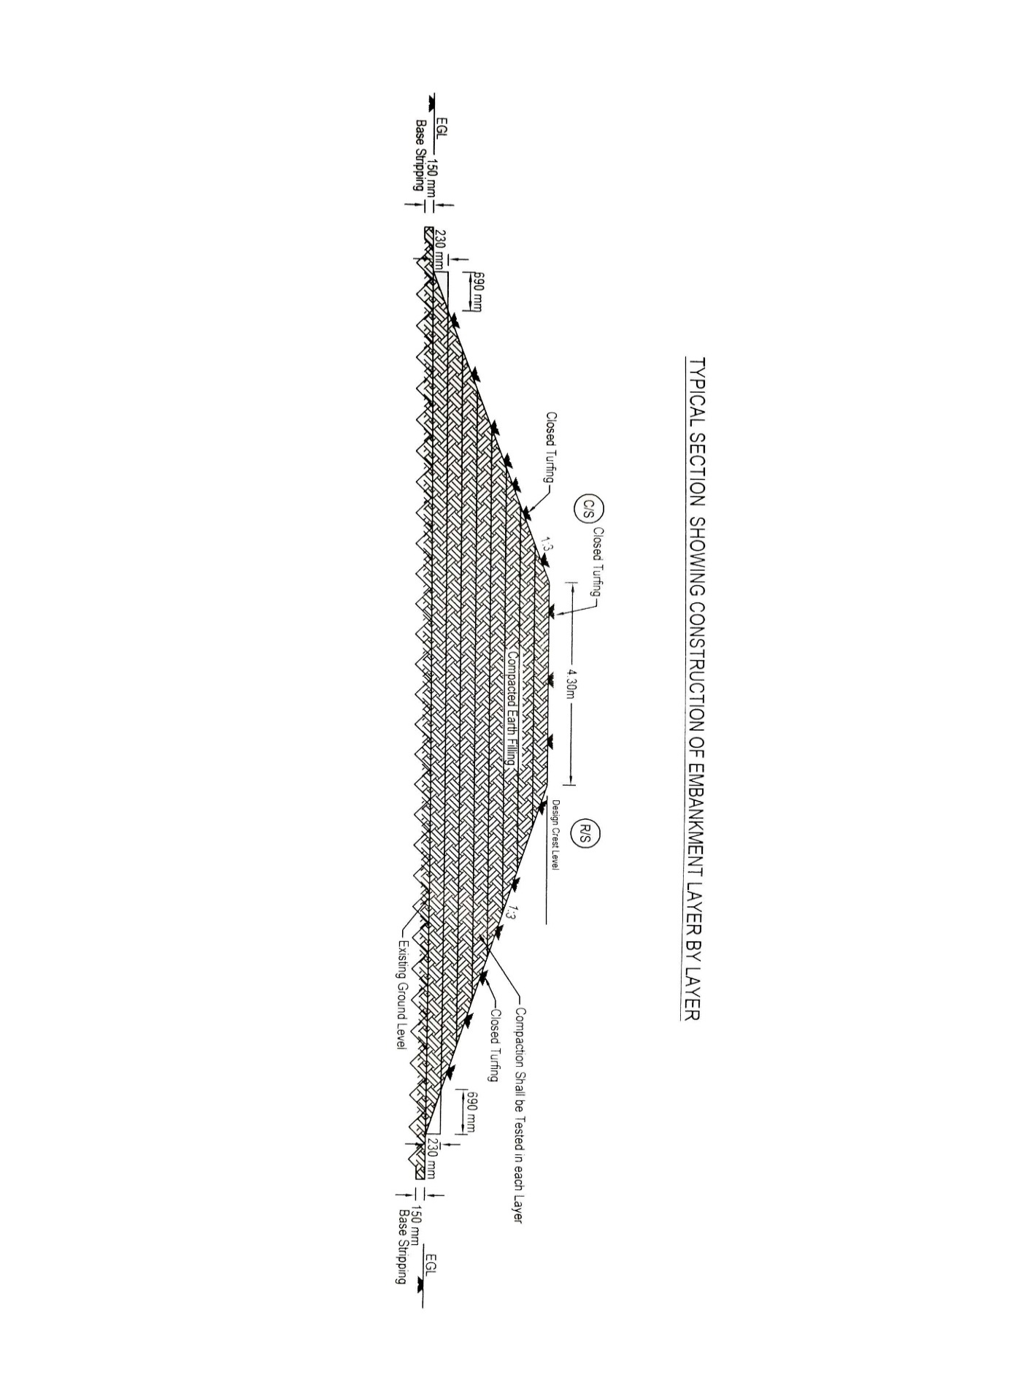
Schematic plan for layer by layer compaction of submersible embankment

Slide 51
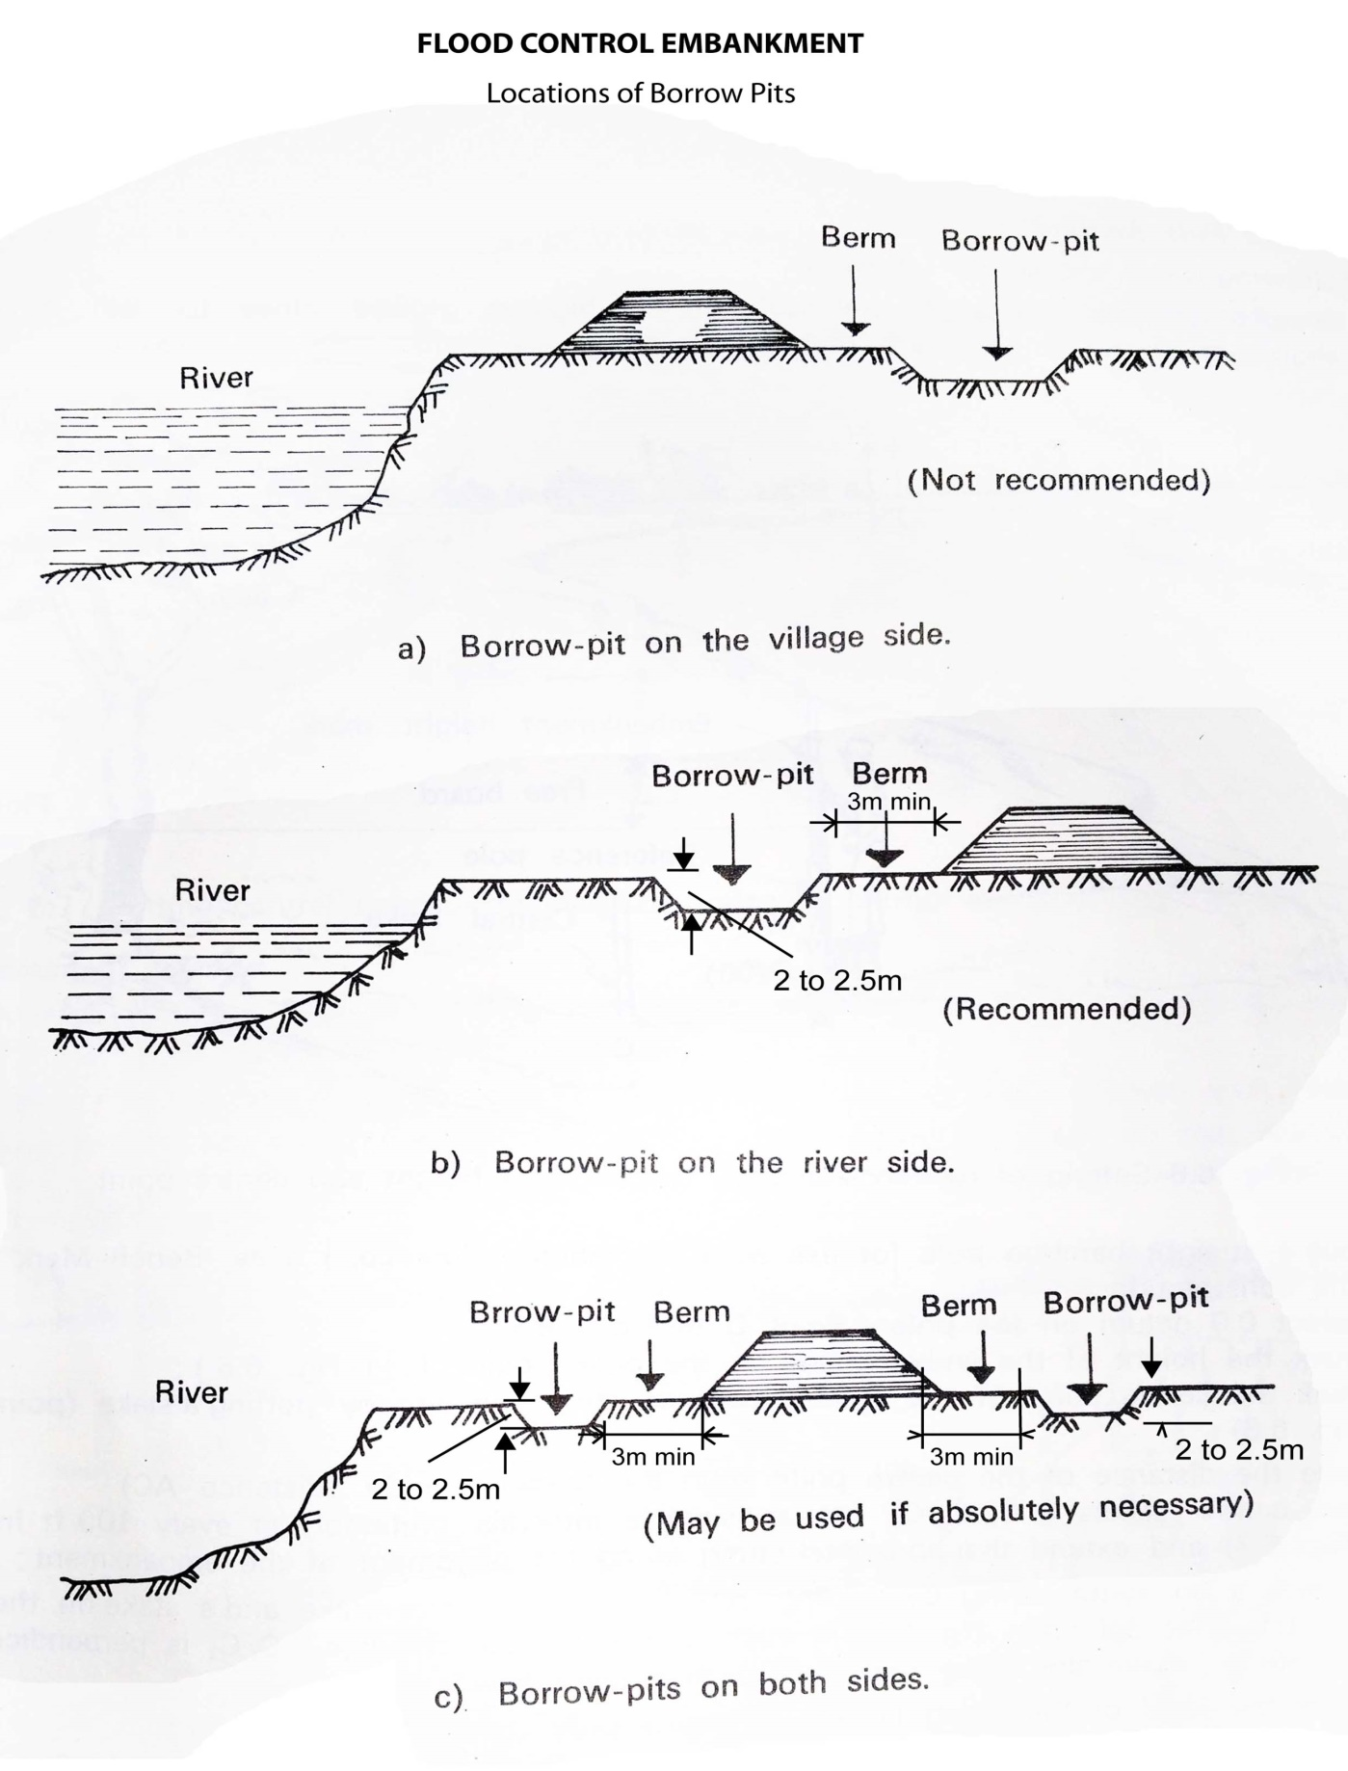
Location of Borrow Pits from The Toe of Embankment
(a) If Earth is Borrowed From The Country Side
20 m

Slide 52
Location of Borrow Pits from The Toe of Embankment
(b) If Earth is Borrowed From The River Side
20m

Slide 53
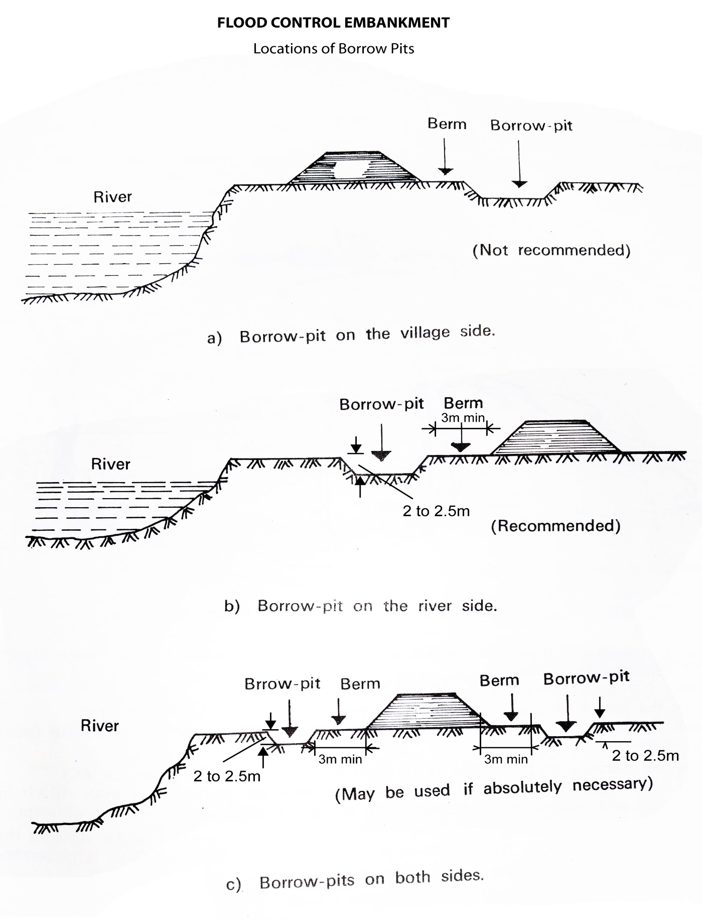
Location of Borrow Pits from The Toe of Embankment
(c) If Earth is Borrowed From Both Side
20m
20m

Slide 54
Quality Control Plan for Pilot Embankment Protection Work
Type A Protective Work Start: Finish: Length: Start of reporting period: Report Finished Date:
Work Item/Material | Unit | Work Executed/ Material Consumed in Last 30 days | Name of Test | Relevant Test Standard | No of Test Required as Per Specification | No of Test Performed | No of Test Passing Threshold Value | No of Test Do Not Passing Threshold Value | Remarks
CC Block | Nos |  | Compressive Strength by Core Cutting | ASTM C42
Cement | Kg |  | Fineness Test | ASTM C786
 |  |  | soundness Test | ASTM C151
 |  |  | Setting Time | ASTM C403
Fine Aggregate | cum |  | Fineness Modulus | ASTM C127
Coarse Aggregate | cum |  | Gradation Test | ASTM C36
 |  |  | Specific Gravity and Water Absorption | AASHTO T85
 |  |  | Aggregate Impact Value | BS812-112
 |  |  | Los Angles Abrasion Test | AASHTO T 96
Geo Textile Filter | sqm |  | Mass per unit area
 |  |  | Thickness under a pressure of 2 kPa
 |  |  | Apparent / Effective Opening size
 |  |  | Horizontal Permeability
 |  |  | Vertical Permeability -
 |  |  | Grab Tensile Strength
 |  |  | Strip Tensile Strength
 |  |  | CBR Puncture Resistance

Slide 55
Work Item/Material | Unit | Work Executed/ Material Consumed in Last 30 days | Name of Test | Relevant Test Standard | No of Test Required as Per Specification | No of Test Performed | No of Test Passing Threshold Value | No of Test Do Not Passing Threshold Value | Remarks
 |  |  | Elongation at maximum force (machine direction MD)
 |  |  | Elongation at maximum force (CMD)
 |  |  | Permeability (Velocity Index for a head loss of 50 mm- V H50
 |  |  | Ultra-Violet (UV) Resistance
Submersible Embankment Construction | cum |  | Atterberg's Limit(Plastic Limit & Liquid Limit) | ASTM D4318
 |  |  | Grain Size Distribution | ASTM D422
 |  |  | Standard Proctor Test | AASHTO T180
 |  |  | Moisture Content | ASTM D4346
 |  |  | Dry Density | AASHTO T191
Enclosure: Test Reports Stated Above.
This is to certify that all the tests has been performed as per relevant standard and work has been done with full conformity to specification.
Sub-Divisional Engineer | SAE/SO | Field Supervision Engineer | Field Inspector | Representative of Contractor | Representative of project Director
Recommended By
Concerned Executive Engineer
Approved By
Project Director

Slide 57
Thank you

